Slide 1



Data Analysis, Results & Interpretation

Slide 2
Data analysis
Research objectives
Reduce bedsores
Research questions
Does protocol A work better than protocol B for reducing bedsores?
Status Quo – Initial Assumption (Null hypothesis)
Protocol A and B produce same % bedsores
Where you want to go - Conclusion you’d like to reach (Alternative hypothesis)
Protocol A and B results in different % bedsores (one better than other)
Notes:
Your data analysis actually begins when you form your research questions and the associated hypotheses you plan to “test” to address your research objective(s) of interest.
For example your ultimate research objective may be to reduce bedsores. However, from a practical standpoint what you really want to compare is will a new or alternate procedure (or protocol or technology or method) reduce bedsores more than current practice.
To address this specific research question your hypothesis boils down to “is procedure A different (not equal to) procedure B”. Thus, the NULL hypothesis is assumed to be the STATUS QUO or rather this is the hypothesis you want to DISPROVE or REJECT (i.e. the procedures are the same – no difference) in favor of the ALTERNATIVE hypothesis (that the 2 procedures are different and one is better than the other by some non-zero amount).
This process of setting up your research question and forming your hypothesis GUIDE which statistical tests or models you will then run to TEST your hypothesis.
Also HYPOTHESIS TESTING forms the basis of logic for drawing conclusions and interpreting your statistical analysis results.

Slide 3
Framework for assessing the evidence
Threshold for assessing that outcome is real [SIGNIFICANCE]
What is the level at which you want to be sure that your result was not obtained by just pure chance?
Usually set at 1-5% level of chance, i.e. 95-99% confidence in results
How much “risk” you’re willing to live with
What is the level of “risk” assumed that you missed a real outcome [POWER] usually10-20%
BOTH critical to determine BEFORE the study is performed and any data collected

Slide 4
Framework for assessing the evidence
Once you determine the level of confidence you want to achieve and the amount of risk you’re willing to live with…
How large an outcome do you expect/hope to see? To achieve clinical relevance? To change practice? [EFFECT SIZE]
How large a SAMPLE SIZE is needed (given all of the above)
Time
Money/resource constraints

Slide 5
4 integrated keys
TRADEOFFS
Significance
Power
Effect size
Sample size
SIGNIFICANCE set BEFORE – confidence level desired for conclusions?
POWER set BEFORE – level of risk that you missed something
EFFECT SIZE - determined from data or estimated or stated from previous observations and clinical goals
SAMPLE SIZE is usually the MAIN option you can adjust within budget and study time constraints.

Slide 6
What constitutes evidence?
Big Sample Sizes in the 1000’s
Everything is statistically significant…
Is it clinically significant/relevant?
It is actionable?
Small Sample Sizes
Nothing statistically significant
But were clinically significant changes seen?
Was the difference due to the “intervention”/”treatment”? Or due to something else (that you measured or not)?

Slide 7
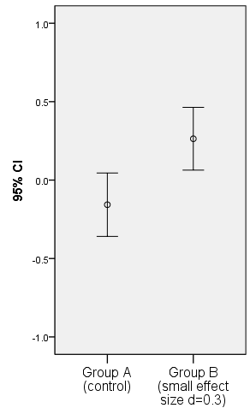
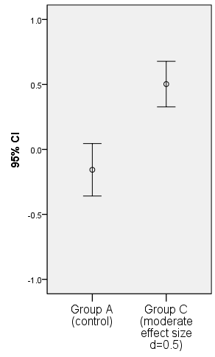
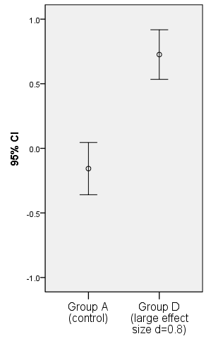
Visualize effect size – ERROR BARS
SMALL
MEDIUM
LARGE

Slide 8
SLIDE CREDIT – Susan E. Shapiro, PhD, RN, FAAN
Facts
The facts are really not at all like fish on the fishmonger’s slab. They are like fish swimming about in a vast and sometimes inaccessible ocean; and what the fisherman catches will depend partly on chance, but mainly on what part of the ocean he chooses to fish in and what tackle he chooses to use – these two factors being, of course, determined by the kind of fish he wants to catch. By and large, the fisherman will get the kind of facts he wants.
E.H. Carr, 1967, quoted in Pedhazur and Schmelken, 1991

Slide 9
Classic Hypothesis Testing
SLIDE CREDIT – Susan E. Shapiro, PhD, RN, FAAN
Population =10mil
Group of interest = 5 mil
Your region = 10k
Your sample = 100

Slide 10
Q&A Discussion

Slide 11
Contact info
Melinda Higgins, Ph.D
Senior Biostatistician; Associate Research Professor
Nell Hodgson Woodruff School of Nursing
Emory University
404-727-5180
melinda.higgins@emory.edu

